Slide 1
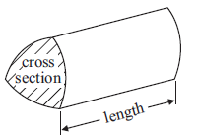
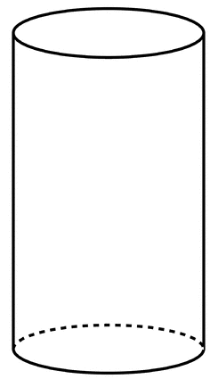
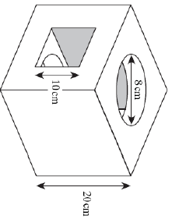
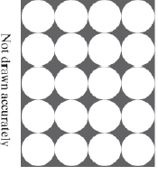
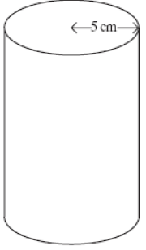
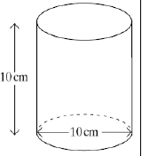
Prior Knowledge
Volume of a prism =
What is surface area?
Draw the net of a Cylinder
Extending your knowledge
Use the area of a circle formula to find
the area of the cross section.
Use the volume of a prism formula to
find the volume of the cylinder.
Use the net that you have drawn to help find the surface area of the cylinder. (you will need the circumference formula)
Area of a circle =
Circumference of a circle =
4cm
12cm
Circles -> Cylinders
Extension Questions
Twenty cylinders are packed in a box of height 10cm. The diagram shows how the cylinders are arranged in the box. The shaded area is the space between the cylinders.
Work out the volume inside the box that is not filled by the cylinders. Give your answer in terms of π.
Exam questions
The diagram shows a cylinder. The diameter of the cylinder in 10cm, the height of the cylinder is 10cm.
Calculate the volume of the cylinder. Give your answer in terms of π.
The volume of the cylinder is 250cm³ find the height to 2 decimal places.
Find the surface area of the cylinder.
A solid cube has a square hole cut through horizontally and a circular hole cut through vertically. Both holes are cut centrally in the appropriate faces.
Calculate the volume remaining after the holes have been cut.

