Slide 1

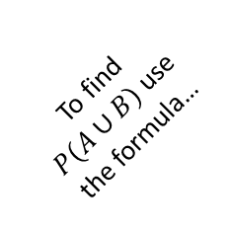
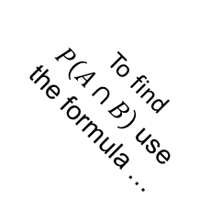
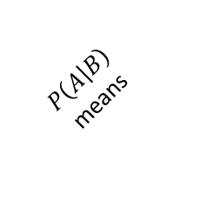



To find $P(A∪B)$ use the formula…
A & B are mutually exclusive if …
$P\left(A | B\right)$
means
To find $P\left(A∩B\right)$ use the formula …
A & B are independent events if …
$P(A∪B)$ means …
$P\left(A∩B\right)$ means…
To find $P\left(A | B\right)$
Use the formula…
Fold your fortune teller along the lines and use it to check how much you know about probability.
Any answers you don't know use your notes or textbook to find out.

