Slide 1
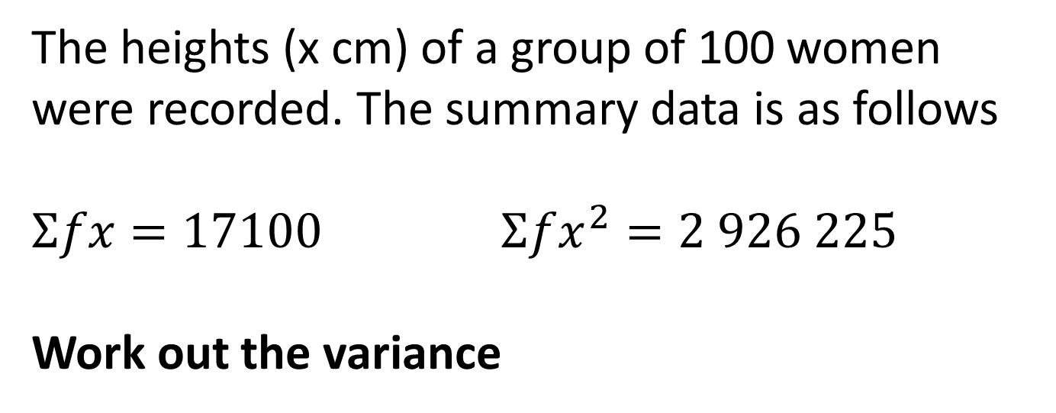
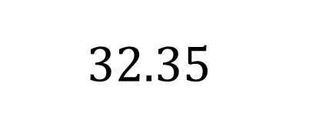
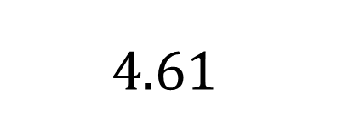
The heights (x cm) of a group of 100 women were recorded. The summary data is as follows
$Σfx=17100$ $Σfx^{2}=2 926 225$
Work out the variance
A
$$4.61$$
B
171.12
C
$$32.35$$
D
21.25
Stats 1
Notes:
D

Slide 2
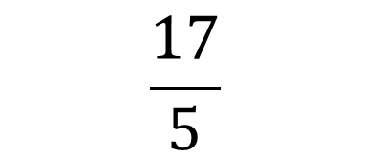
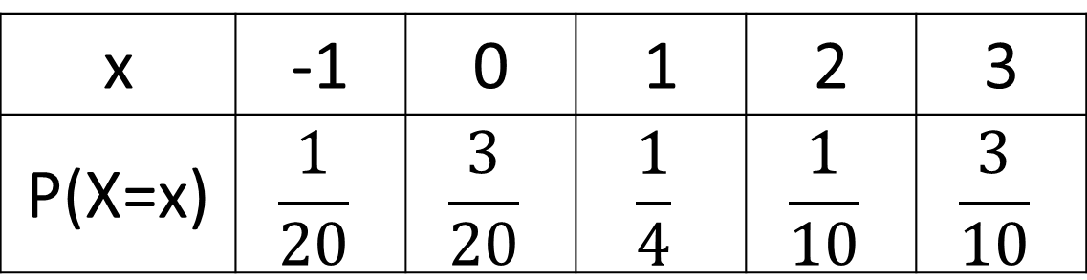
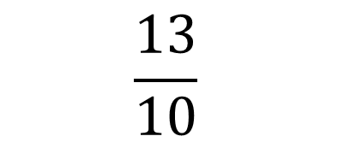

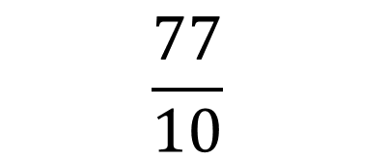
The random variable x has the following distribution:
Find E(X)
x | -1 | 0 | 1 | 2 | 3
P(X=x) | $$\frac{1}{20}$$ | $$\frac{3}{20}$$ | $$\frac{1}{4}$$ | $$\frac{1}{10}$$ | $$\frac{3}{10}$$
A
$$\frac{17}{5}$$
B
$$\frac{77}{10}$$
C
$$\frac{7}{5}$$
D
$$\frac{13}{10}$$
Stats 1
Notes:
D

Slide 3
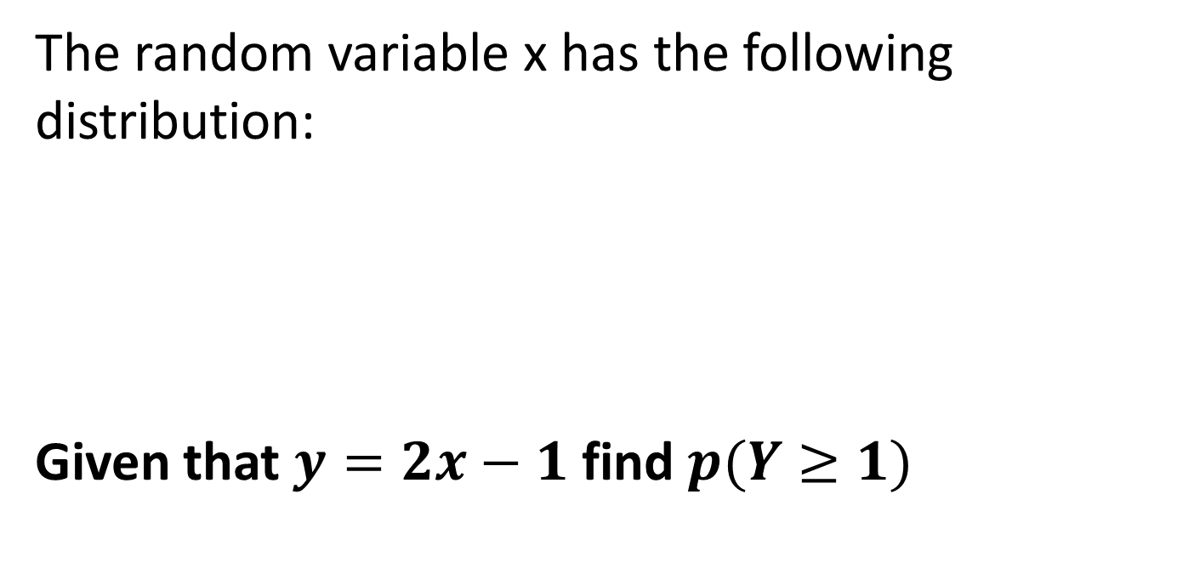

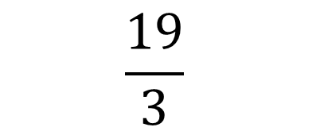
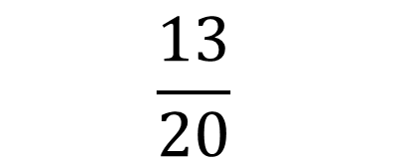

The random variable x has the following distribution:
Given that $y=2x−1$ find $p(Y≥1)$
x | -1 | 0 | 1 | 2 | 3
P(X=x) | $$\frac{1}{20}$$ | $$\frac{3}{20}$$ | $$\frac{1}{4}$$ | $$\frac{1}{10}$$ | $$\frac{3}{10}$$
A
$$\frac{1}{5}$$
B
$$\frac{13}{20}$$
C
$$\frac{19}{3}$$
D
$$1$$
Stats 1
Notes:
B

Slide 4
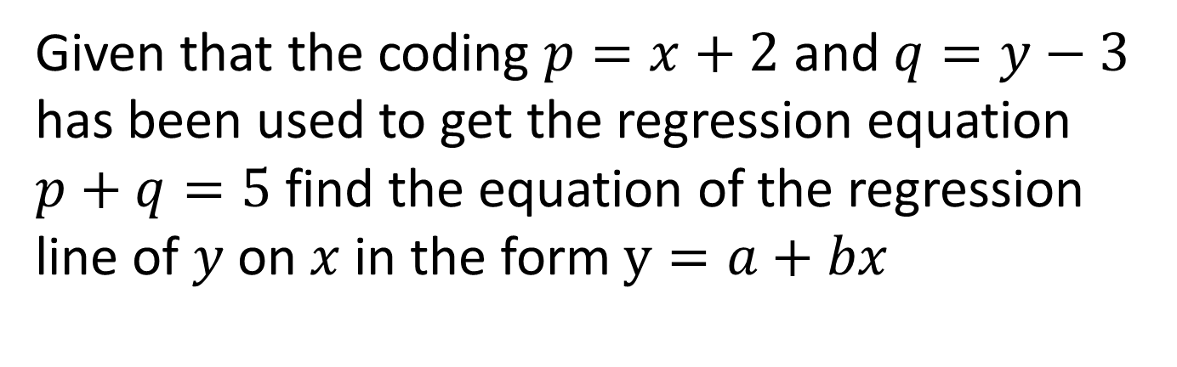
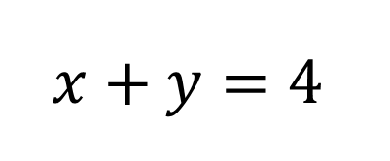
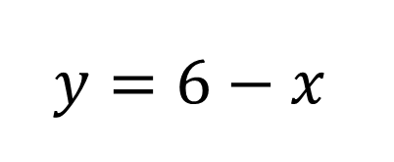
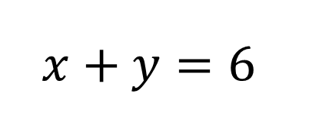
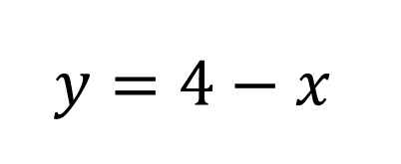
Given that the coding $p=x+2$ and $q=y−3$ has been used to get the regression equation $p+q=5$ find the equation of the regression line of $y$ on $x$ in the form $y=a+bx$
A
$$y=4−x$$
B
$$x+y=6$$
C
$$y=6−x$$
D
$$x+y=4$$
Stats 1
Notes:
C

Slide 5
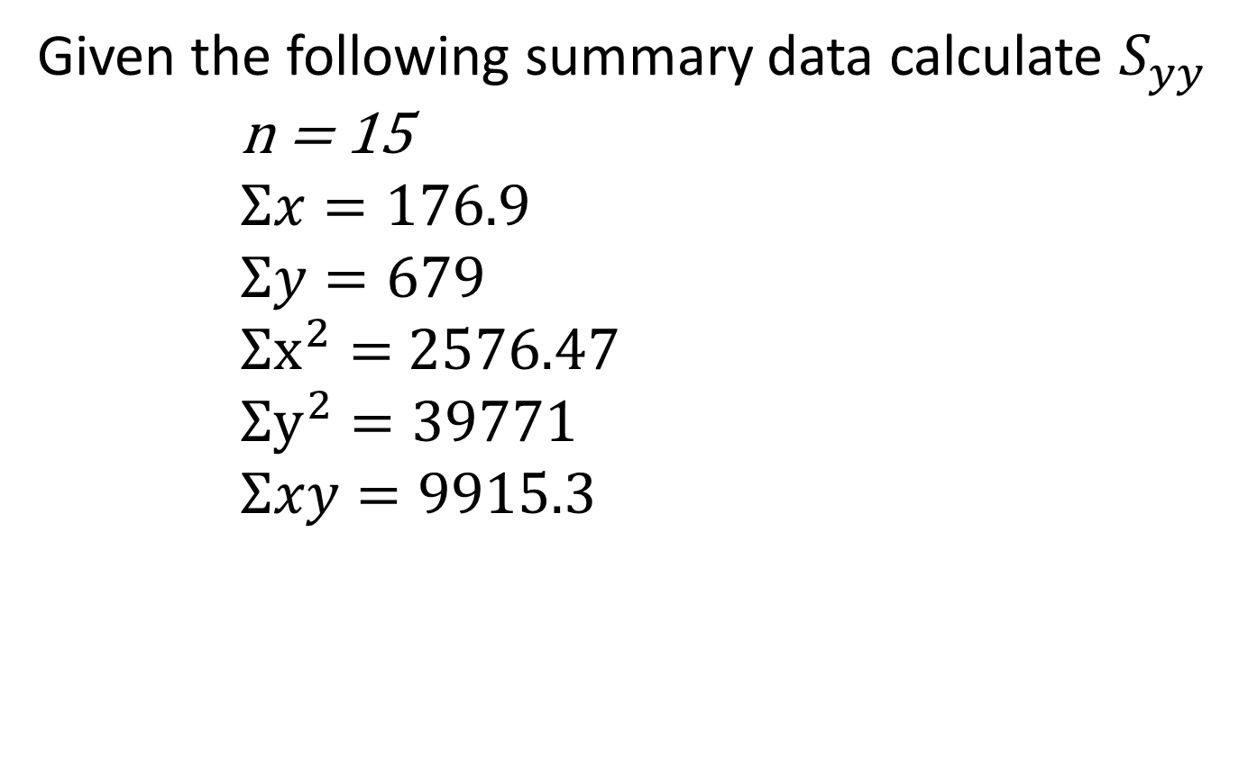
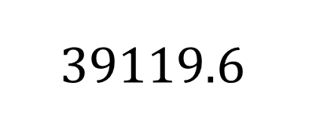
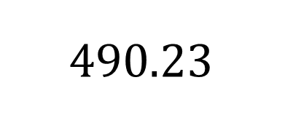
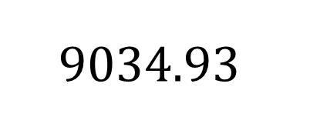
Given the following summary data calculate $S_{yy}$
      n = 15
      $$Σx=176.9$$
      $$Σy=679$$
      $Σx^{2}=$ 2576.47
      $$Σy^{2}=39771$$
      $$Σxy=9915.3$$
A
$$9034.93$$
B
$$490.23$$
C
$$39119.6$$
D
458389.6
Stats 1
Notes:
A

Slide 6
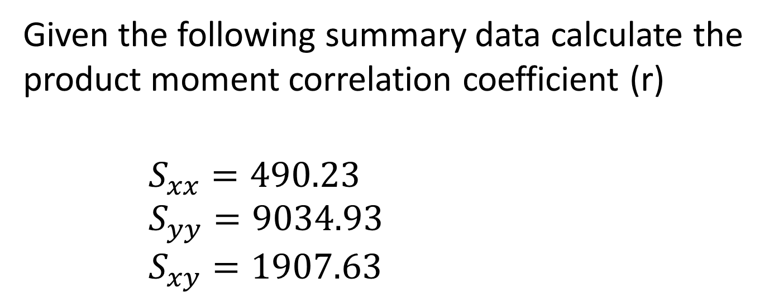
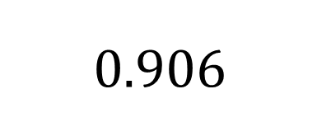
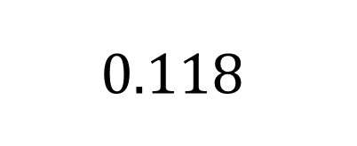
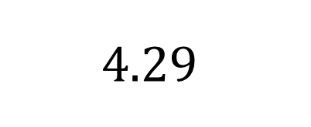
Given the following summary data calculate the product moment correlation coefficient (r)
      $$S_{xx}=490.23$$
      $S_{yy}=9034.93$
      $S_{xy}=1907.63$
A
$$4.29$$
B
$$0.118$$
C
$$0.906$$
D
9.343
Stats 1
Notes:
C

Slide 7




Which of the following describes a positive skew?
A
$$Q_{2}−Q_{1}<Q_{3}−Q_{2}$$
B
$$Q_{2}−Q_{1}>Q_{3}−Q_{2}$$
C
$$mean<median<mode$$
D
$$mean>median>mode$$
Stats 1
Notes:
A and D

Slide 8
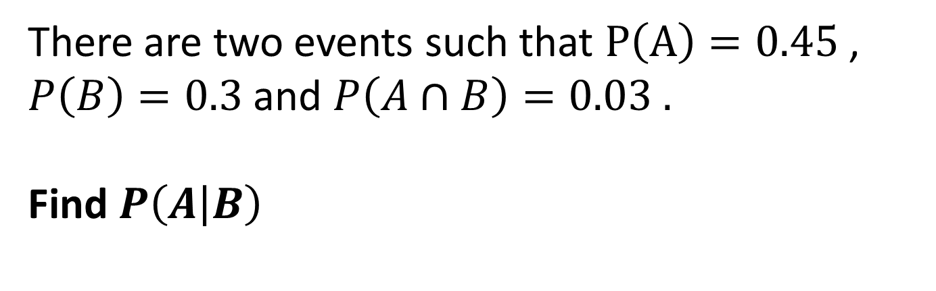
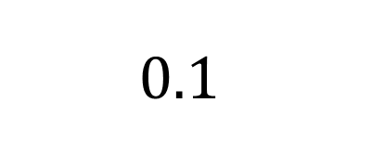
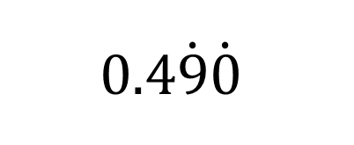
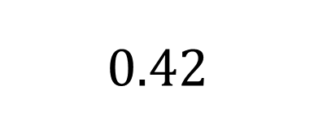
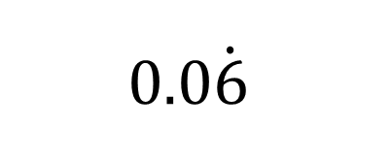
There are two events such that $P\left(A\right)=0.45$, $P\left(B\right)=0.3$ and $P\left(A∩B\right)=0.03 .$
Find $P\left(A | B\right)$
A
$$0.0\dot{6}$$
B
$$0.42$$
C
$$0.4\dot{9}\dot{0}$$
D
$$0.1$$
Stats 1
Notes:
D
A is P(B given A)

Slide 9
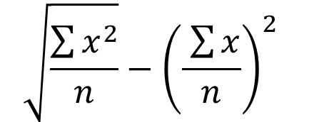
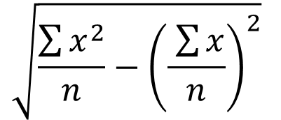
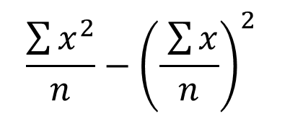
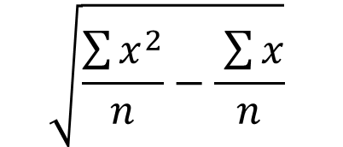
Which of the following is the correct formula for standard deviation?
A
$$\sqrt{\frac{\sum{x^{2}}}{n}}−{\left(\frac{ \sum{x}}{n}\right)}^{2}$$
B
$$\sqrt{\frac{\sum{x^{2}}}{n}−\frac{ \sum{x}}{n}}$$
C
$$\frac{\sum{x^{2}}}{n}−{\left(\frac{ \sum{x}}{n}\right)}^{2}$$
D
$$\sqrt{\frac{\sum{x^{2}}}{n}−{\left(\frac{ \sum{x}}{n}\right)}^{2}}$$
Stats 1
Notes:
D

Slide 10
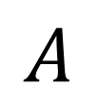
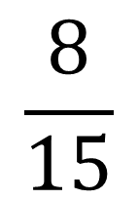


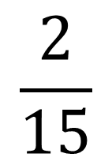
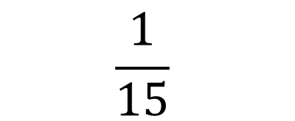
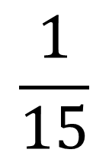
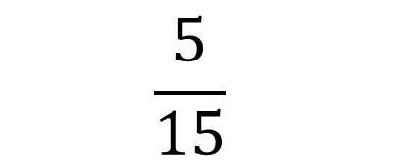
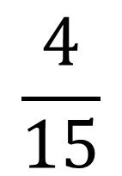
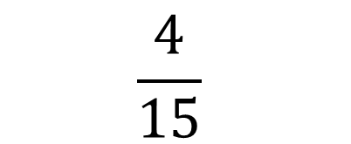
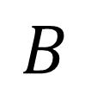
Find $P(A∩B^{′})$
$$A$$
$$B$$
$$\frac{4}{15}$$
$$\frac{1}{15}$$
$$\frac{2}{15}$$
$$\frac{8}{15}$$
A
$$\frac{4}{15}$$
B
$$\frac{5}{15}$$
C
$$\frac{1}{15}$$
D
$$\frac{1}{3}$$
Stats 1
Notes:
A

Slide 11
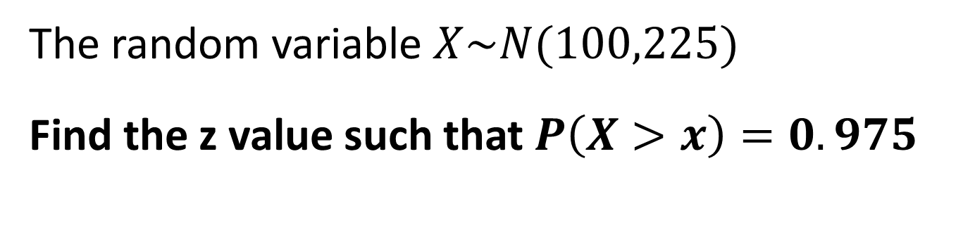
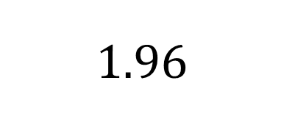
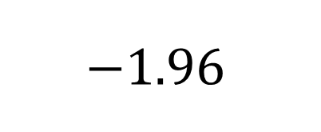
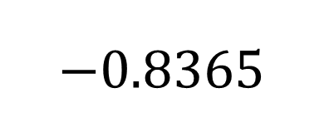
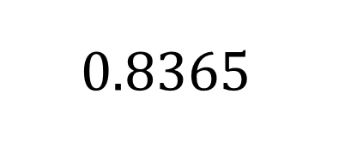
The random variable $X\sim N(100,225)$
Find the z value such that $P\left(X>x\right)=0.975$
A
$$0.8365$$
B
$$−0.8365$$
C
$$−1.96$$
D
$$1.96$$
Stats 1
Notes:
C

Slide 12
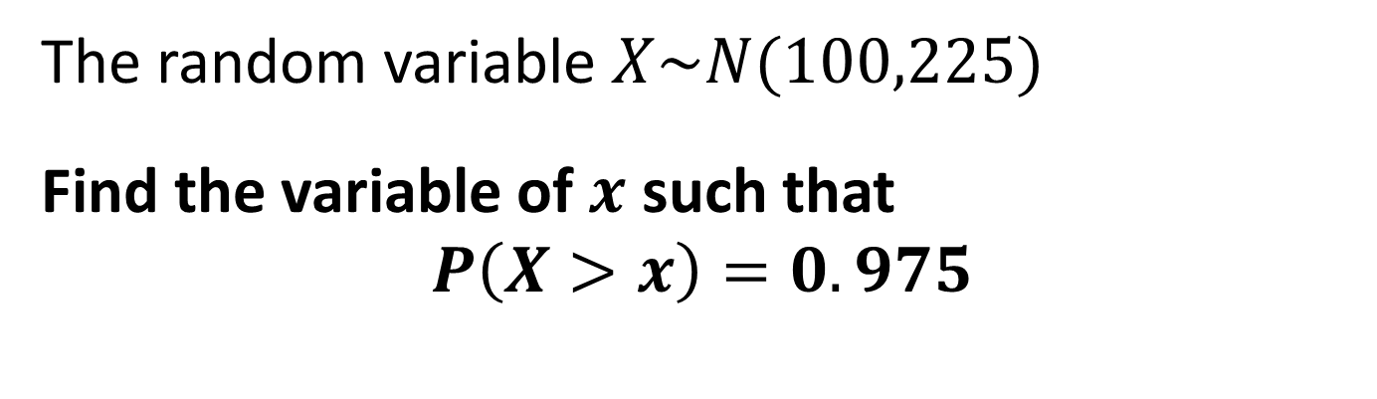

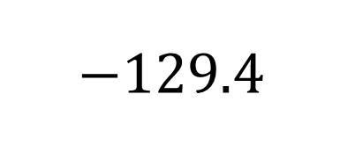
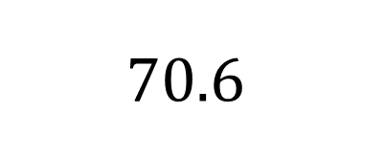
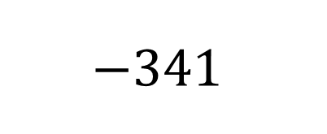
The random variable $X\sim N(100,225)$
Find the variable of $x$ such that
$$P\left(X>x\right)=0.975$$
A
$$−341$$
B
$$70.6$$
C
$$−129.4$$
D
$$29$$
Stats 1
Notes:
B

Slide 13






What is the frequency for 25-50?
$$P\left(X>a\right)=0.975$$
1
0.8
0.6
0.4
0.2
0
A
$$0.6$$
B
$$41.67$$
C
$$15$$
D
$$30$$
Stats 1
Notes:
C

Slide 14




The heights of a large group of men are normally distributed with a mean of 175cm and a standard deviation of 4cm.
A man is randomly selected from the group.
Find the z value for a height of 170cm
A
$z =$ 1.25
B
$z =$ 0.3125
C
$z =$ − 1.25
D
$z =$ − 0.3125
Stats 1
Notes:
C

Slide 15




The heights of a large group of men are normally distributed with a mean of 175cm and a standard deviation of 4cm.
A man is randomly selected from the group.
Find the probability that the man is shorter than 170cm
A
$$0.8944$$
B
$$0.2133$$
C
$$0.1056$$
D
$$0.8925$$
Stats 1
Notes:
C

