Slide 1

$$F\left(x\right)+a$$ | Transformations |  | Trig Graphs | $$y=tanθ$$
$$aF\left(x\right)$$
 |  |  |  | $$y=cosθ$$
$$F(x+a)$$
 |  |  |  | $$y=sinθ$$
$$F\left(ax\right)$$

Slide 2
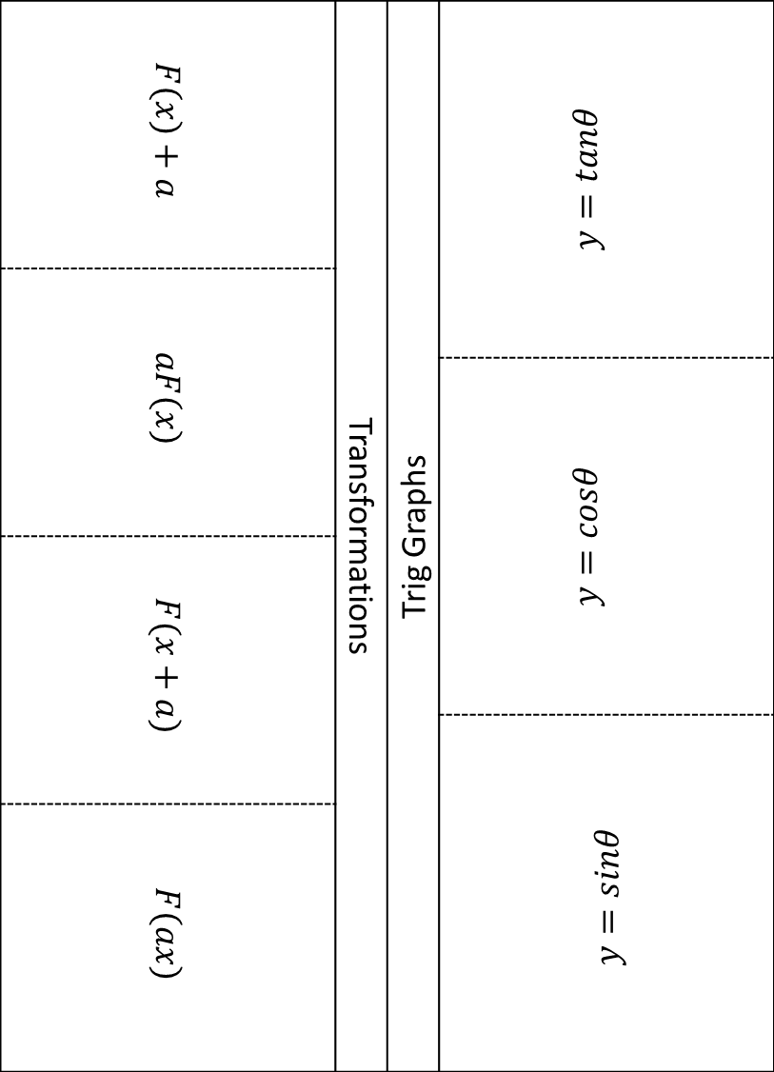
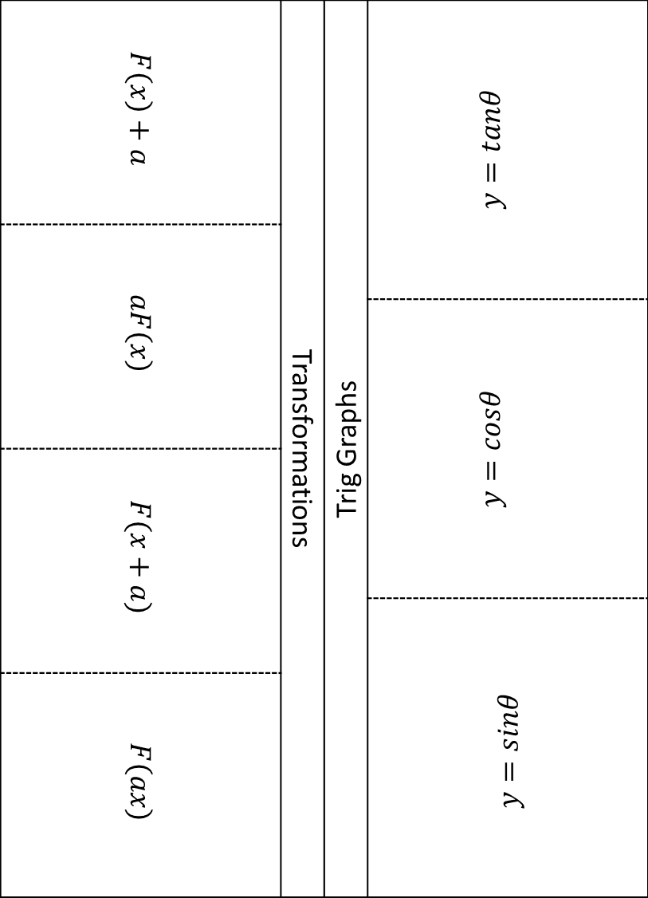
$$F\left(x\right)+a$$ | Transformations | Trig Graphs | $$y=tanθ$$
$$aF\left(x\right)$$
 |  |  | $$y=cosθ$$
$$F(x+a)$$
 |  |  | $$y=sinθ$$
$$F\left(ax\right)$$
$$F\left(x\right)+a$$ | Transformations | Trig Graphs | $$y=tanθ$$
$$aF\left(x\right)$$
 |  |  | $$y=cosθ$$
$$F(x+a)$$
 |  |  | $$y=sinθ$$
$$F\left(ax\right)$$
Notes:
Use this one if you want to save paper. Stick the central section down and the tabs lift up either side

