Slide 1
GCSE Maths Quiz 1

Slide 2
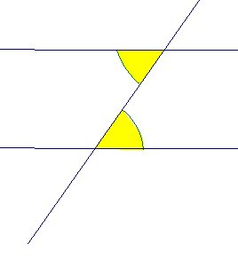
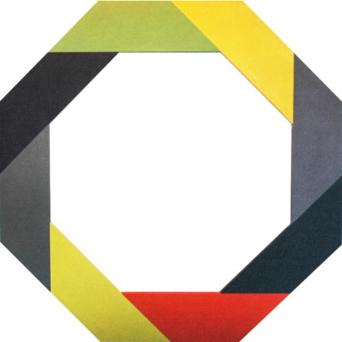
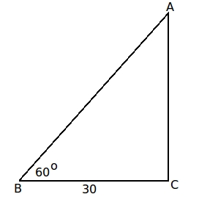
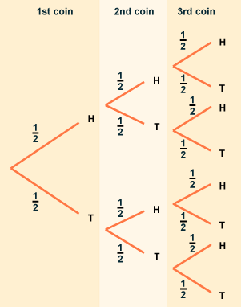
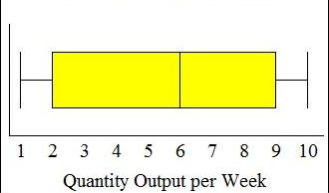
Section 1: Picture round
What is the name given to the pair of angles shown?
2. What is the name of this shape?
3. What is the name of the side you need to find?
42º
x
x
4. What is this type of diagram called?
5. What is this called?

Slide 3
Section 2: Multiple choice
What is the Lowest Common multiple of 6 and 9?
  1
  3
  18
  54
2.Which of these do you need when doing an enlargement?
  Centre of enlargement
  Scale factor
  Centre of rotation
  Both a and b
3.Fully factorise 2x² – 4xy
  2x(x - 4xy)
  2x(x² -2y)
  2x(x - 2xy)
  2x(x - 2y)
4.Which of these do you not need for your exam on Thursday 26th May?
  Ruler
  Calculator
  Compass
  Protractor
5.There are 21 milk chocolates in a box of 24 the rest are dark. What is the ratio of milk to dark chocolates in its simplest form?
  21:24
  7:8
  21:3
  7:1

Slide 4
Section 3: Formulas
Pythagoras’ theorem?
Area of a circle?
Area of a triangle?
Circumference of a circle?
5. Trigonometry in right angled triangles (1 mark each)?

Slide 5
Section 4: Quick calculations
Find angle x in picture 1.
What is the interior angle of the shape in picture 2?
Find the length of side x in picture 3.
What is the probability of getting 3 heads?
(hint use picture 4)
What is the median in picture 5?

Slide 6
Answers

Slide 7
Section 1: Picture round
What is the name given to the pair of angles shown?
2. What is the name of this shape?
3. What is the name of the side you need to find?
42º
Opposite
Octagon
x
Alternate
x
4. What is this type of diagram called?
5. What is this called?
Box Plot or Box and Whiskers diagram
Tree diagram

Slide 8
Section 2: Multiple choice
What is the Lowest Common multiple of 6 and 9?
  1
  3
  18
  54
2.Which of these do you need when doing an enlargement?
  Centre of enlargement
  Scale factor
  Centre of rotation
  Both a and b
3.Fully factorise 2x² – 4xy
  2x(x - 4xy)
  2x(x² -2y)
  2x(x - 2xy)
  2x(x - 2y)
4.Which of these do you not need for your exam on Thursday 26th May?
  Ruler
  Calculator
  Compass
  Protractor
5.There are 21 milk chocolates in a box of 24 the rest are dark. What is the ratio of milk to dark chocolates in its simplest form?
  21:24
  7:8
  21:3
  7:1

Slide 9
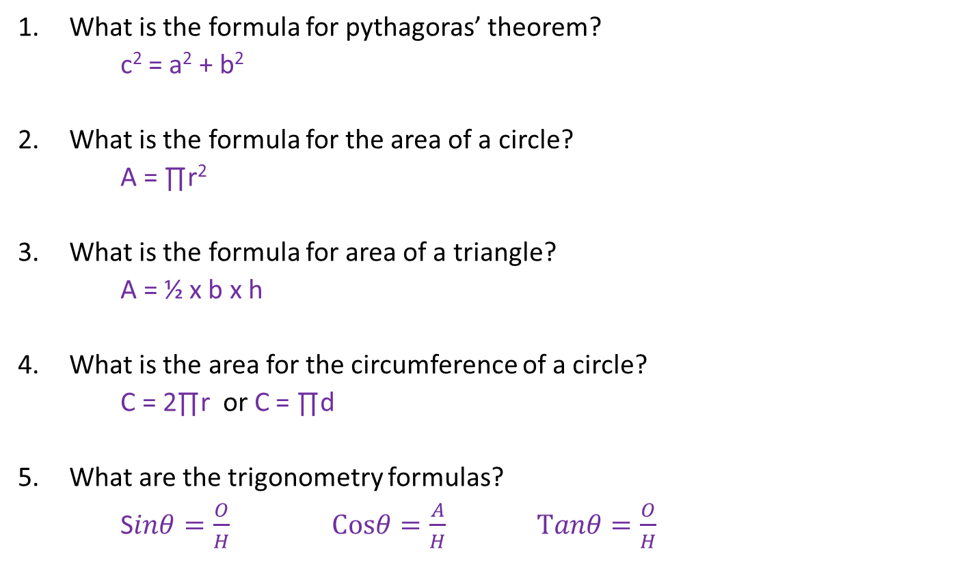
Section 3: Formulas
What is the formula for pythagoras’ theorem?
c² = a² + b²
What is the formula for the area of a circle?
A = ∏r²
What is the formula for area of a triangle?
A = ½ x b x h
What is the area for the circumference of a circle?
C = 2∏r or C = ∏d
5. What are the trigonometry formulas?
S$inθ=\frac{O}{H}$ $Cosθ=\frac{A}{H}$ $Tanθ=\frac{O}{H}$

Slide 10
Section 4: Quick calculations
Find angle x in picture 1.
138º
What is the interior angle of the shape in picture 2?
Rotational
Find the length of side x in picture 3.
52
What is the probability of getting 3 heads?
1/8
What is the median in picture 5?
6

